Slide 1
Track Design
Our driving simulator will be accompanied by tracks custom made to demonstrate the functionality of our Predictive Correction system in realistic driving environments

Slide 2
Goals
Track must demonstrate prevention system in effect
Must create situations in which the human driver will likely fail if unaided
Situations for failure must be based on realistic challenges of real-world roads

Slide 3
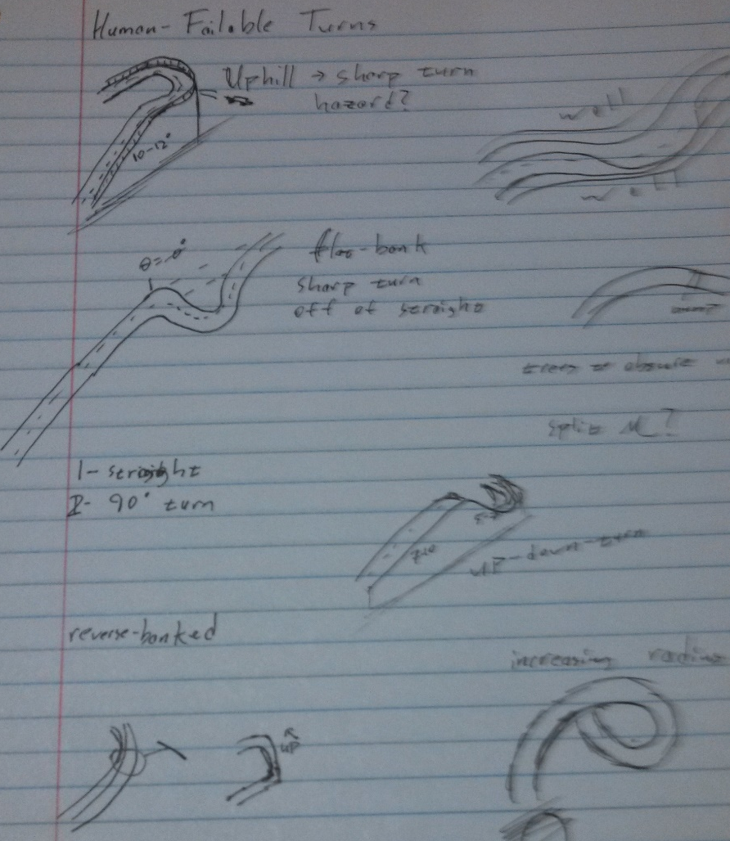
Realistic Road Hazards
Must focus on hazardous features common on standard highways and state roads
Visibility obstruction a common theme in hazardous road features
While the human driver may not asses (or even see) these turns correctly, our correction system will
http://www.mathworks.com/cmsimages/58961_wl_sm_3danim_fig1_wl.jpg

Slide 4
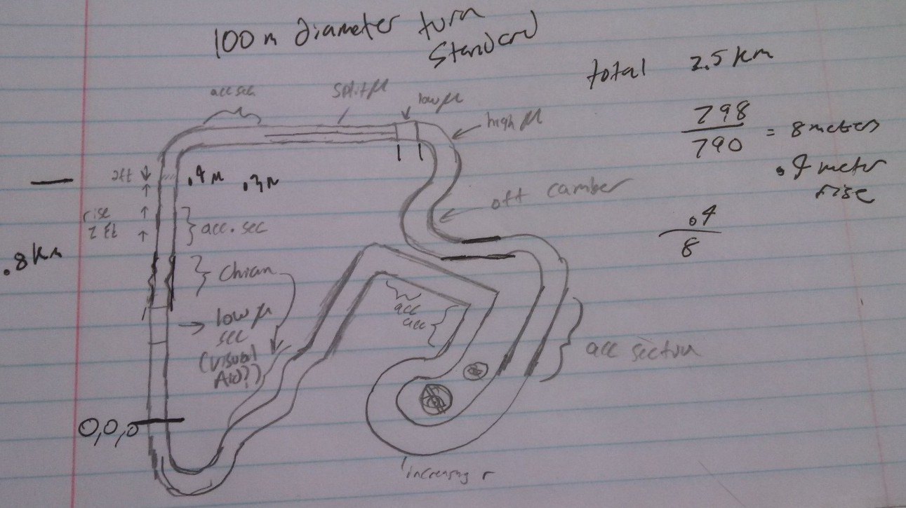
Current Drafts Pt.1
Inspired by traditional race circuit
Promotes a race environment to push car to speeds where Preventive Correction will be required to make turns
Designer: Brian Davidson (Senior – ME)

Slide 5
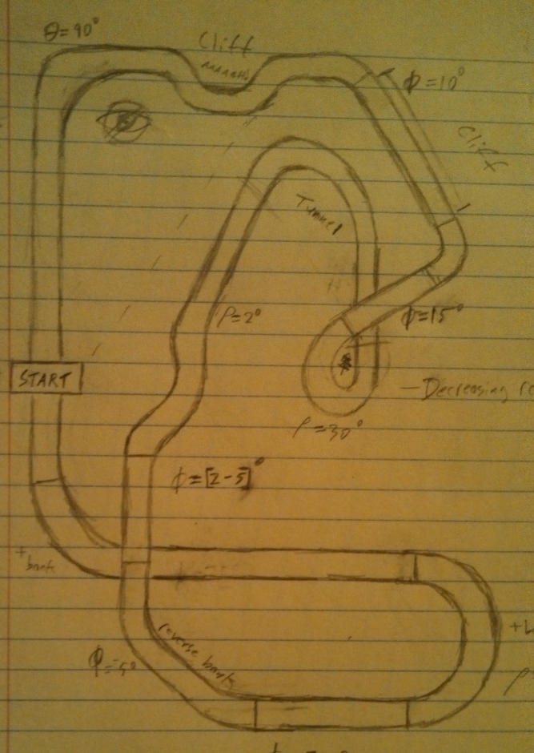
Current Drafts Pt. 2
Inspired by mountain road hazards
Remains faithful to traditional race circuit design
Utilizes heavy visibility restriction for human driver difficulty
Designer: Dirk Hortensius (Senior – CS)
http://www.mathworks.nl/help/releases/R2013b/sl3d/examples/vr_octavia_graphs_02.png

Slide 6
Further Considerations
Track does not have to be a circuit. This will allow us to properly emulate mountain road conditions common in single-vehicle accidents
Our current simulator prototype design does not support changes in road friction. In later track designs, this may be implemented to represent traction hazards common in winter driving conditions (black ice, slick turns, etc.)

